Slide 1
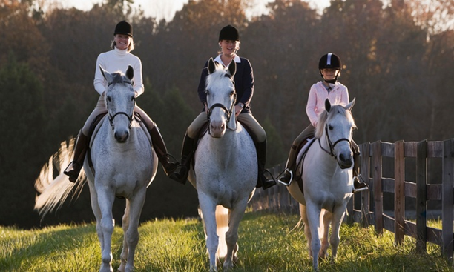
In Harmony with Horsemasters
Juliet Sadd – RS Carolina
USPC Annual Meeting
Los Angeles, CA
Jan 26-28, 2017

Slide 2
USPC Horsemasters membership
* Note separate axis scales used to illustrate trends, but are not proportionate
Total membership trending lower
11% decrease over 5 years, 24% decrease over last 8 years
Horsemasters membership growing, but from zero base
102% increase over 5 years, 215% increase over last 8 years
HMX has grown to 11% of Total membership, but is not great enough YET to offset decline in youth members.
38 of 42 Regions (90%) have HMX members.
There are 5 HMX only clubs in USPC at end 2016.

Slide 3
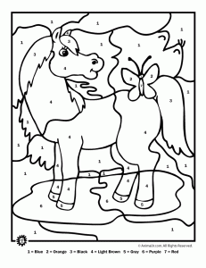
Horsemasters History
Conceived as ‘Adult Volunteer’ organization to support Clubs
2001 Pilot program launched
2007 Horsemasters became permanent program
2015 Horsemasters became regular ‘pony club members’
Membership data:
159 Pony Clubs have 863 HMX members (34% of Clubs, 12% of their membership)
21 Riding Centers have 60 HMX members (21% of RCs, 4% of their membership)
Total 180 Clubs/RCs with 923 HMX = 31% penetration of Clubs/ RCs, 11% of USPC members
5 Pony Clubs are HMX only
..by the numbers
Two thirds of USPC clubs do not have any Horsemasters members 15 years into the program.
USPC Annual Meeting Los Angeles, Jan 2017

Slide 4
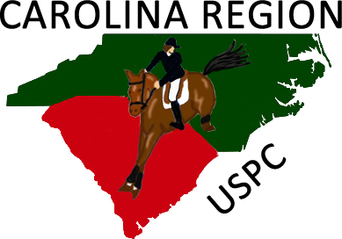
Carolina Region
@ Oct 2016
Total HMX % HMX
42 3 7%
32 0
34 8 23%
32 32 100%
26 0
36 8 22%
17 4 23%
15 0
13 0
7 0
13 0
16 0
7 0
7 0
4 2 50%
0
315 53 17%
Greenville Foothills
Eno Triangle
Yadkin Valley Hounds
Eno Triangle Master
Hidden "K" Stable RC
River Valley
Rocky River
Brickhouse Equestrian Center
Lowcountry
Cardinal II
Pee Dee
Aiken County
Moore County
Triad
Sandy Ridge
Palmetto
TOTAL REGION
History
Early adopters HMX
Strong HMX advocate - Susan Poulton
2016 membership profile
HMX 6 of 16 clubs , ~40% of clubs
HMX 17% of Region members
Eno Triangle Masters established separate club 2015
HMX not in Riding Centers

Slide 5
Who are these Horsemasters?
Majority are Experienced adult horse men and women
Grew up with horses, but not usually pony clubbers
Lifelong Horse owners
Adult amateur competitors
Foxhunters, Eventers, Dressage enthusiasts
Parents of current youth members that want to participate in clinics/rallies
USPC graduates – recent and older alum – many National certifications
Horse professionals – trainers, competitors, instructors
Friends of pony club parents and HMX leaders
USPC Annual Meeting Los Angeles, Jan 2017

Slide 6
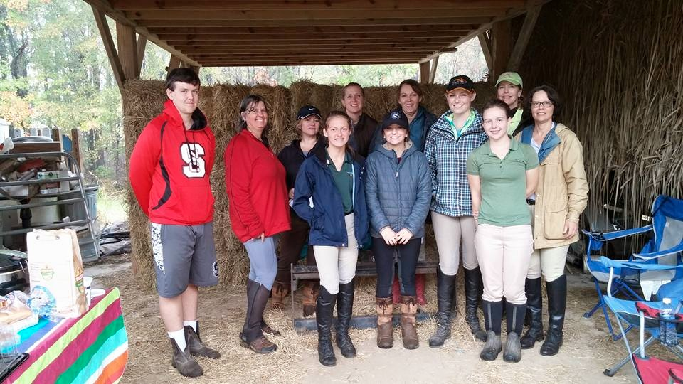
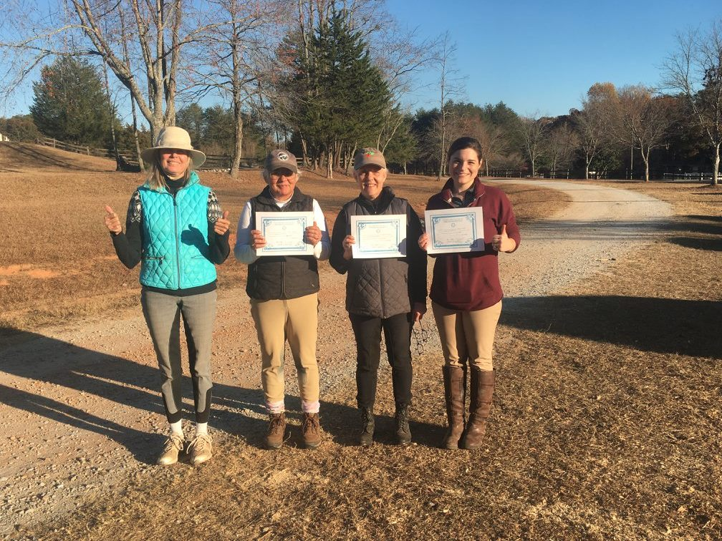
Horsemasters Models
Carolina Region has 3 working models of Horsemaster membership
ENO TRIANGLE MASTERS
Preliminary level:
Expanding
Membership
Intermediate level:
Evolving
Participation
Advanced level: Entity
Rocky River PC,
Yadkin Valley Hunt PC
Mainly parents
Participate in clinics
Grouped with kids
Organize occasional club activities – trail ride
Fox Hunt members
Greenville Foothills PC
River Valley PC
Parents, Alumni, Friends
Horse professionals
Participate in clinics in own groups where numbers warrant
Volunteer leaders
HMX as instructors, coaches
Participate in rallies, championships, certifications
Stand alone club
Members mainly new to pony club
Parents, alumni, friends
Organize own activities clinics, dinners, speakers, camp – strong social aspect
May include youth members
Organize joint events
Volunteer when asked
USPC Annual Meeting Los Angeles, Jan 2017

Slide 7
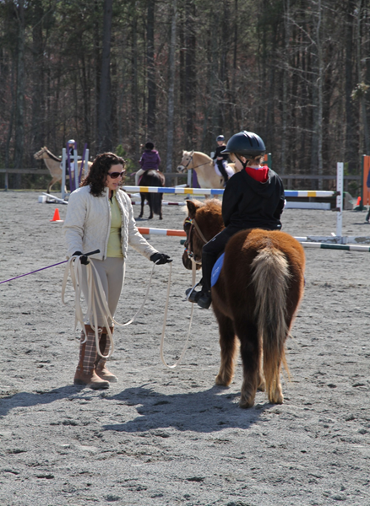
How do clubs benefit from Horsemasters?
Adult Role Models
Parents, alumni, professionals, experienced horsemen
Adults understand ‘it is not the horse’s fault’ and model for children
Adults better understand ‘how a horse thinks’ and nuance of body language, temper, etc
Demonstrate Horsemanship as a life long pursuit
Participation in mounted clinics
More participants, lower cost per participant
Attract and afford top instructors
Demonstrate patience with self and horse to children
Frequently add humor and encouragement for younger members
Networking and knowledge
Unmounted pony club lessons and speakers
Local horse information and resources – vets, trainers, hay sources, etc
Volunteer Resource
Able to organize a club activity independently of club leaders
Annual Trail Ride, Gymkhana, Mini Horse Trial, Mock Rally
Assist with club activities
Fundraising, concessions, jump repair, horse shows, paperwork entries, scoring, certifications
If Qualified, can instruct, coach, HM judges for rallies
Participation in all activities
Regional rallies, clinics, camps
Championships
Certifications
Brittany – HMX member, grad HA
Doing one on one instruction to help a beginning member at a pony club clinic.
USPC Annual Meeting Los Angeles, Jan 2017

Slide 8
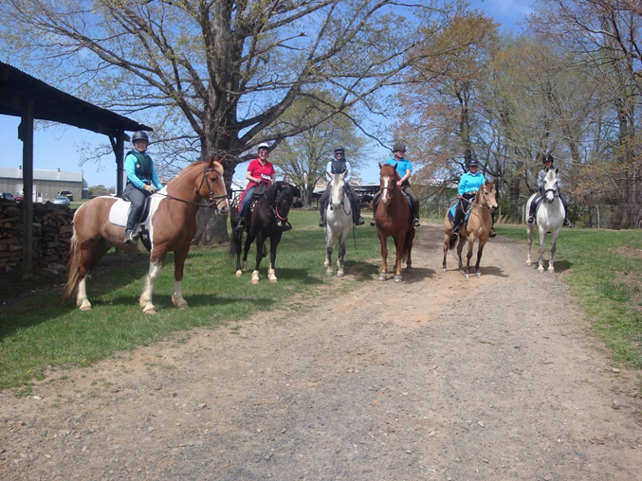
Why do adults join Horsemasters?
Participation in mounted clinics
More reasonable cost than other adult
groups/trainer groups
Convenience to pony club parent
Low pressure educational opportunity
Exposure and training of young/client horses
Networking and knowledge
Unmounted pony club lessons and speakers
Local horse information and resources
– vets, trainers, hay sources, etc
Contribution of own knowledge and experience
Camaraderie
Adult horse friends
‘like minded equestrian enthusiasts’
Youth horse friends
Opportunity to participate
Continued pony club engagement for members/alumni over age 25
Engagement with youth members – sense of purpose, sharing of knowledge/experience
National organization with structure, goals and volunteer opportunity in Equestrian sport
Regional rallies
Championships
Certifications – sense of direction and accomplishment
USPC Annual Meeting Los Angeles, Jan 2017

Slide 9
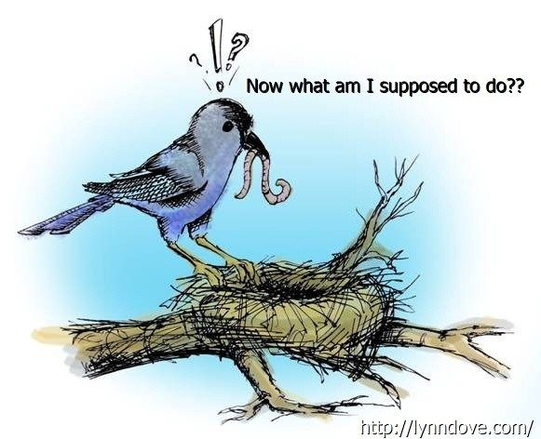
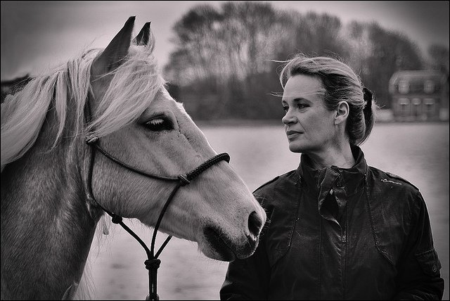
The Empty Nest
From chaos to quiet over night
Loneliness
Lack of purpose
Welcome parents of pony clubbers getting ready to go to college or just off to college…and their horsey friends… into Pony Club!
Empty Nest Advice from Experts:
Learn something – go back to school
Volunteer
Find a hobby
Adopt a pet
Travel
Get a job/start a business
Focus on your health
Build friendships and relationships
HMX
HMX
HMX
HMX
HMX
HMX
HMX
Horsemasters fulfill 7 of 8 recommendations!

Slide 10
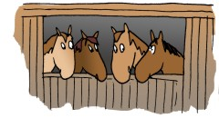
Our Panel
Melon “Mary Ellen” Purcell is a HMX member herself, while also DC and VRS of the Alaska Region. The Alaska Region historically has held the highest percentage of total regional membership comprised of HMX.
Lynn Fischer is a HMX member and was Camino Real (California) RS for many years, as well as having served on the national Horsemasters Program Committee.
Sandy Larson is a Grad A and DC of Greenville Foothills Pony Club, which has several HMX members, although she is not. Sandy is also the new RIC for the Carolina Region, which has qualified several HMX members for Championships.

Slide 11
Panel – How do you respond?!
Polly Pony Club parent is opposed to Horsemasters because ‘adults should not be in the same lessons with children’
Pauline PC parent is upset about Horsemasters being allowed to compete at Rally because they should not compete with kids and ‘take their ribbons.’
Dorothy the DC says it is ‘too complicated to manage lessons and clinics with kids and adults’
Donna the DC says our club is small and we focus on getting National Certifications. There is no place for Horsemasters.
Abby, a prospective Horsemaster, member says ‘I don’t know about doing all the Horse Management stuff….inspections at age 45?! ‘
Janet the Joint DC says she would like to start Horsemasters but doesn’t have any idea where to begin.

Slide 12
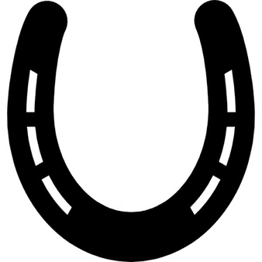
Next Steps
Strengthen Your Club with Horsemasters
Discuss HMX opportunity with your board
Grow HMX if you already have some Horsemasters
Use HMX recruiting material
clinics, camp, rallies, certifications
Utilize HMX as volunteers AHMJ, scoring secretarial, webmasters, instruction
How to get Horsemaster members
Be open to visitors – supplemental insurance
Growth through networking – friends, friends of friends
Invite alumni to clinic or meeting – college age retention
Invite parents to bring a horse and ride at clinic
Be Inclusive, Be Flexible

Slide 13
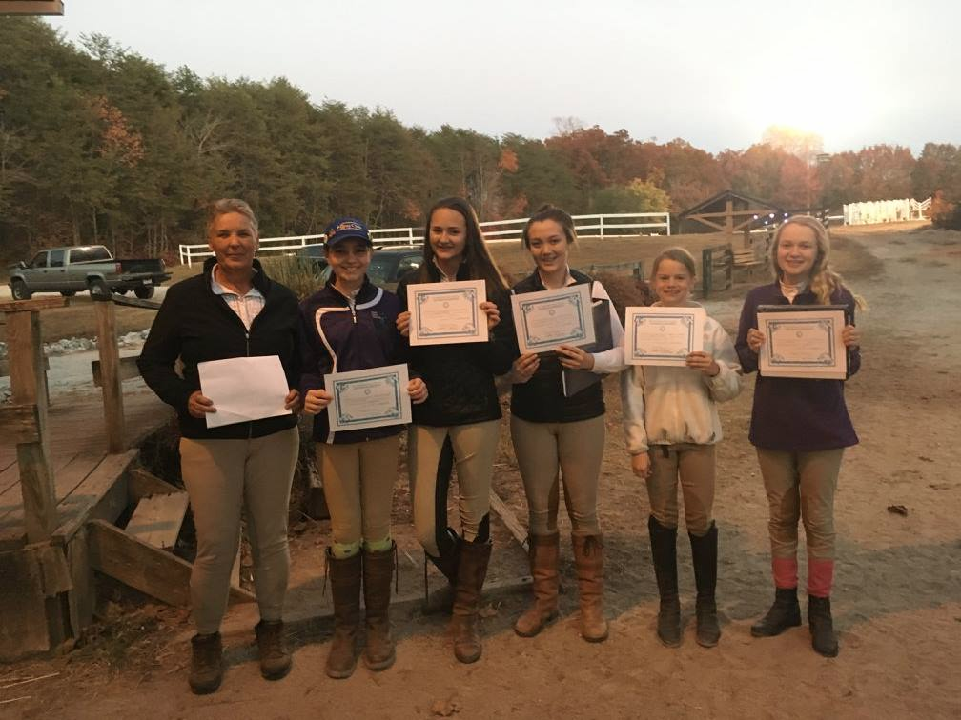
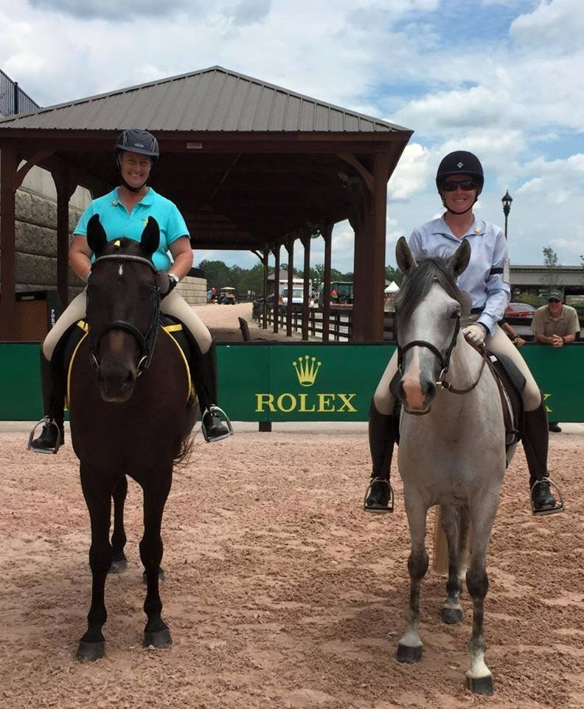
Some Best Practices from Carolina Region
Advice ‘from the horse’s mouth’ ….
Find ‘That One Parent’ - who rides, has friends, and talks it up
Include HMX in regular activities – meetings, clinics, lessons
Approach adult horse management as a ‘bonding challenge’
Keep it Fun
Involve Horsemasters with ‘jobs’ – specific roles at meetings
Have older kids teach Horsemasters (C3, B, H)
Have horsey friends come along to a pony club meeting
Invite foxhunt friends
Include Horsemasters in certifications IF they want – goal achievement
Personalities matter
Posters at Horse Trials
Target parents who ride
Horsemaster competitors
at USPC Championships 2016
Horsemasters and youth members
completing D and C certifications together.

Slide 14
More Best Practices
Concern | Reality | Best Practice
My club is too small to include Horsemasters | You need HMX to grow your membership and enable you to do more activities | Find that ‘one horsey parent’ who will join, spread the word, and invite horsey friends to join.
My club is too big for Horsemasters | You can add a couple of Horsemasters to your roster to the benefit of your club, your region, and your horse community. | Find an alumna to join and get your club used to the idea. Grow from there. Create stand alone HMX club when you reach ‘critical mass’ of 8-10 members.
Adults and children in lessons together | It can work really well and benefit both | Arrange jumping lessons by rider ability. Arrange flat lessons by rider age. Ensure instructor ability to engage multiple learning styles
Horse Management requirements put off adults | Most experienced adult horsemen have good standards of horse care, equipment, and handling. Many have greater knowledge than PC SOPs. HMX will have ‘required equipment’ and then some in their truck or trailer at any given moment. Inexperienced HMX welcome HM education. | Be sensitive to adult perspective. Always put in context of ‘why’ pony club does it this way. Be respectful and listen to other perspectives and experience of horse care. Allow pony clubbers to explain ‘things’ to HMX. Can be fun and result in learning for both. Approach with humor and flexibility esp at rallies.
USPC Annual Meeting Los Angeles, Jan 2017

